Slide 1

Ontario Institute for Education Leadership
Ontario Leaders Collaborating for Student Achievement, Equity
and Well-being
STRENGTHENING EQUITY, DIVERSITY AND INLCUSION AWARENESS
Personal and Social Identities
Notes:
About this learning opportunity:
This learning opportunity is designed to strengthen leaders’ effectiveness in having conversations about all matters related to Equity, Diversity, and Inclusion (EDI). This is a generic presentation that will be enriched by what you bring to the learning. Draw on and apply your personal identity, your lived experiences and diverse background to help ensure that the learning strengthens your leadership for equity.
Although you can work through the presentation and its activities on your own, your learning will be enhanced with the support of a facilitator in a group setting or with a mentor/coach. It can also be adapted for a range of professional learning contexts for diverse audiences including aspiring leaders, practicing leaders. school staff and parent groups.
The materials used throughout this presentation will help you get started. Extend your learning by using the reflective worksheet provided with each presentation and by accessing materials that are included in the module; i., e., articles, micro-podcasts, scenarios and resources.

Slide 2
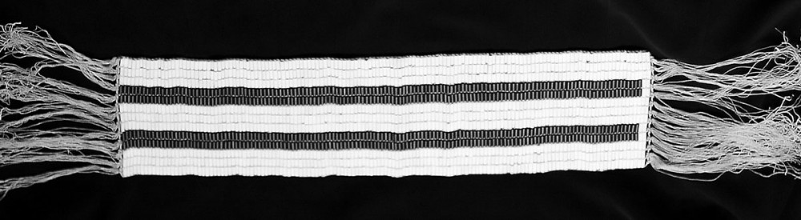
Ontario Institute for Education Leadership
Ontario Leaders Collaborating for Student Achievement, Equity
and Well-being
LAND ACKNOWLEDGEMENT
This Photo by Unknown Author is licensed under CC BY-SA-NC
Notes:
Offer the land acknowledgement for the land on which the learning is taking place. Change the image to one that is most suitable for your context and its Indigenous peoples.
This excerpt from the Resource Guide, Introduction to Land Acknowledgements https://www.hwcdsb.ca/data/ie/Land%20Acknowledgement.pdf, EXPLAINS the significance of a land acknowledgement.
What is a land acknowledgement? A land acknowledgement is one small action in the process of decolonization, where the indigenous inhabitants of the land are recognized at the start of an event or meeting. It allows the ongoing systematic oppression of Indigenous peoples to be brought to the forefront of our minds, even if for a brief moment, to further reconciliation work. We encourage all groups who are serious about reconciliation to adopt land acknowledgments while understanding that it is simply one action, and should be where anti-oppression work starts, not ceases.

Slide 3
Ontario Institute for Education Leadership
Ontario Leaders Collaborating for Student Achievement, Equity
and Well-being
Suggested Community Agreements
BE PRESENT - even if it is uncomfortable
BE BRAVE - bring your fear and courage
BE RESILIENT - expect messiness and commitment
BE AUTHENTIC - speak your lived experience
Notes:
Learning in a group provides an opportunity to build capacity to engage effectively in necessary conversations.
The slide offers one option for community agreements.
In his book, Courageous Conversations about Race – A Field Guide for Achieving Equity in Schools, 2nd edition 2015, Glenn Singleton recommends four agreements of courageous conversations:.
Stay engaged
Experience discomfort
Speak your truth, and
Expect and accept disclosure.
Community Agreements are helpful in establishing a safe learning environment where necessary conversations about equity can occur.
Other suggestions for what to include in a community agreement include:
Unlearn and unpack your beliefs
Experience discomfort and rethink your positionality
Challenge your own assumptions and bias
Accept new learning and consider next steps
Another option is to create your own by setting an intention that reflects the way you will honour these agreements.
PROCESS CONSIDERATION:
Involve the group in the establishment of community agreements.

Slide 4
Ontario Institute for Education Leadership
Ontario Leaders Collaborating for Student Achievement, Equity and Well-being
Willingness to be Disturbed
“It is very difficult to give up our certainties—our positions, our beliefs, our explanations. These help define us; they lie at the heart of our personal identity. Yet I believe we will succeed in changing this world only if we can think and work together in new ways. Curiosity is what we need. We don’t have to let go of what we believe, but we do need to be curious about what someone else believes. We do need to acknowledge that their way of interpreting the world might be essential to our survival”
~ Margaret Wheatley, 2002
Notes:
PROCESS CONSIDERATIONS:
Take quiet time to read and reflect on these words from Turning to One Another: Simple Conversations to Restore Hope to the Future by Margaret Wheatley (2002).
What thoughts come to mind as you read?
Consider the relevance of these words as you embark on a learning experience that will challenge you to think about how your personal identity has implications on your social identity.

Slide 5
Ontario Institute for Education Leadership
Ontario Leaders Collaborating for Student Achievement, Equity
and Well-being
Starting with Yourself – Exploring Personal Identity
Awareness of your personal identity is essential in building self-awareness and leading for equity, diversity and inclusion.
Ask yourself:
  What defines you as a person?
  What makes you who you are?
  What makes you a person who is unique and different from every other person?
Come up with as many words as possible and record them.
Notes:
Identity is filled with complications and shades of meaning, for example, gender, race, religion, sexual identity, economic class, education level...
Most of us probably don't realize how many factors make up our sense of "me."
Recall what you learned about your implicit biases and the plan you made to eliminate them.
Recognize that without awareness of your own identity it is unlikely that you will be successful in leading for equity, diversity and inclusion.
Why? As humans, bias is hardwired into our brains and interwoven in our identity.
This underscores the value of exploring your own identity and building awareness of it as you interact with others and learn about their identities.
PROCESS CONSIDERATIONS:
On your own, reflect on a time when you thought about your personal identity.
Respond to the questions in the slide by recording first thoughts.
What defines you as a person?
What makes you who you are?
What makes you a person who is unique and different from every other person?
Talk to an elbow partner about any aspect about what you’ve recorded that you feel comfortable sharing.
Reflect on how it felt to think about your personal identity

Slide 6
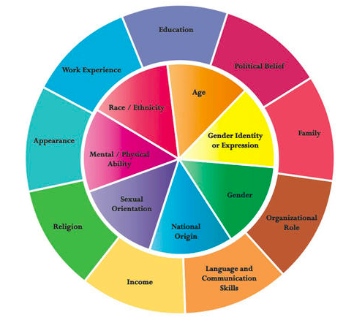
Personal Identity Wheel
Use the Identity Wheel to help you think more deeply about the many identities you carry with you.
Notes:
This is one example of an identity wheel. Other examples can be found at https://www.google.com/search?q=identity+wheel+visual&sxsrf=APq-WBunD9-YSaw53HaZVlfV62koTMwm1w:164729451031
The Personal Identity Wheel is one approach to uncovering terms and concepts that speak to how you feel about yourself.
It can help us put into words our most deeply held concepts of self.
It can be an eye-opening experience that enhances our self-awareness and in turns helps us to build a stronger, safer working environment for everyone.
PROCESS CONSIDERATIONS:
Review the responses you recorded to the questions about your personal identity in the previous slide.
Consider the following questions to expand your list of responses and your insights about your personal identity:
Which part in this wheel did you inherit?
Which part did you choose explicitly?
Which parts might have been imposed on you?
Which parts give you the most pride and satisfaction?
Are there any in this wheel that are in flux for you, that might be ambiguous?
Are there any that you have to filter or monitor how they show up?
Have any of these changed over time?
Which parts are most explicit, and which are more in the background?
These are the types of questions related to personal identity that we need to be thinking about and surfacing.
Refer to the Reflective Worksheet section “Exploring Your Personal Identities” and complete your personal identity wheel.
We need to be bringing forward a real examination of who we are and how it influences our relationships and interactions with others.
Knowledge of our personal identity is important as we think about the identities of others and what is referred to as personal and social identities.

Slide 7
Ontario Institute for Education Leadership
Ontario Leaders Collaborating for Student Achievement, Equity
and Well-being
Exploring Social Identity
Social identity is “the set of qualities and beliefs that make one person or group different from others”
– Merriam-Webster dictionary
Notes:
An individual’s social identity indicates who they are in terms of the groups to which they belong.
Social identity groups are usually defined by some physical, social, and mental characteristics of individuals. Examples of social identities are race/ethnicity, gender, social class/socioeconomic status, sexual orientation, (dis)abilities, and religion/religious beliefs.
They are called “social identities” because our society strongly influences how we categorize other people and ourselves based on these identities in significant ways.
Social identities influence the experiences we have as members of any particular group.
They are shaped by common history, shared experiences, legal and historical decisions, and day-to-day interactions.
Social identities also affect personal identities. For example, your social class may have a strong impact on the education you receive and the profession that you end up in.
PROCESS CONSIDERATIONS:
Refer to the Reflective Worksheet section “Exploring Your Social Identities” and complete your social identity wheel.

Slide 8
Ontario Institute for Education Leadership
Ontario Leaders Collaborating for Student Achievement, Equity
and Well-being
REFLECTING ON YOUR PERSONAL AND SOCIAL IDENTITIES
What are the implications of your identities on leading for equity, diversity and inclusion?
What aspects of identity would you like to change? And why?
How do your identities affect your every day life?
Notes:
Personal and social identities have implications for a sense of belonging in an organization.
Any situation that points that a person is different from the rest can threaten a person’s feeling of belonging and safety.
PROCESS CONSIDERATIONS:
Refer to Reflective Worksheet and record your thoughts on the following:
What are the implications of your identities on leading for equity, diversity and inclusion?
What aspects of identity would you like to change? And why?
How do your identities affect your every day life?
Complete the Commitment section of the Reflective Worksheet.
We encourage you to proceed to session four: Belonging and Psychological Safety.

Slide 9
Ontario Institute for Education Leadership
Ontario Leaders Collaborating for Student Achievement, Equity
and Well-being
Resources for Leaders
www.education-leadership-Ontario.ca
https://twitter.com/IELOntario
communication@education-leadership-ontario.ca
www.education-leadership-Ontario.ca
Notes:
We invite you to visit the IEL website to learn more about other resources and research that could be used to support your professional growth.

