Slide 1

Ontario Institute for Education Leadership
Ontario Leaders Collaborating for Student Achievement, Equity
and Well-being
Strengthening Your
Personal Leadership Resources
For Catholic Leaders
Psychological PLRs – Session 1.2
Understanding Who You Are as a Leader
Notes:
This is a generic resource that is enriched by what the leaders bring to the learning.
With this in mind, participants are encouraged to draw on and apply their lived experiences and diverse backgrounds to help ensure that the learning is culturally relevant and responsive.
The Ontario Leadership Framework (OLF) includes a small but critical number of Personal Leadership Resources (PLRs): psychological, social and cognitive which are the focus of this series, Leaders draw on these PLRs to effectively enact the leadership practices of the OLF. While many traits or personal characteristics have been associated with leaders and leadership, the OLF includes only those for which there is compelling empirical evidence. Refer to The Ontario Leadership Framework 2012 - with a Discussion of the Research Foundations to learn more about the relationship between the PLRs and the practices of the OLF.
The Personal Leadership Resources (PLRs) distil evidence about leadership traits and dispositions most likely to influence the effectiveness with which leadership practices are enacted.
The PLRs are research-based traits which effective leaders possess. There are three categories: cognitive, social, and psychological. Within each category there are several specific characteristics which can be improved upon through personal development practices. PLRs are foundational to effective leadership.
There are suggested times for activities over 5 minutes in length.

Slide 2
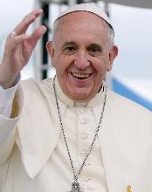
Ontario Institute for Education Leadership
Ontario Leaders Collaborating for Student Achievement, Equity
and Well-being
Lord, we thank You for the marvelous call to educate in the light of the Catholic faith.
Illumine our hearts and minds with the wisdom of Your Spirit,
That our work today might help Catholic educators spread the truth of your Son’s Gospel in all that they do.
We ask You this through Christ our Teacher and Lord.
Amen
Notes:
A Prayer for Catholic School Leaders
Recite the prayer
https://cpco.on.ca/files/9115/1820/8179/1._A_Prayer_for_Leaders_in_Catholic_Education.pdf

Slide 3

Ontario Institute for Education Leadership
Ontario Leaders Collaborating for Student Achievement, Equity
and Well-being
Ice Breaker: Getting to know you!
Please share the following information with the group:
Name
Name one person you admire
Explain the traits the person has that make them incredible.
Notes:
Please share the following information with the group:
Name
Name one person you admire
Explain the traits the person has that make them incredible.
Suggested timing: 10-20 minutes

Slide 4
Ontario Institute for Education Leadership
Ontario Leaders Collaborating for Student Achievement, Equity
and Well-being
What are the Personal Leadership Resources?
Psychological
Cognitive
Optimism
Problem solving expertise
Social
Perceive emotions
Manage emotions
Act in emotionally appropriate ways
Knowledge of effective school and classroom practices that directly affect student learning
Systems thinking
Self-Efficacy
Resilience
Proactivity
Notes:
The Personal Leadership Resources (PLRs) of the Ontario Leadership Framework describe the qualities of effective leaders such as optimism, emotional intelligence and problem-solving abilities, which the research indicates create the variation among leaders in how well they enact leadership practices. School and system leader practices are enacted most effectively when drawing on these PLRs.
Although in some instances the sessions explore the psychological, social and cognitive personal leadership resources, it is important to keep in mind that in practice leaders draw on the PLRs as a whole, interactively. Leaders are not systems thinkers one moment, resilient people the next and successful relationship builders in another. In fact, leaders are all of those things, all of the time and most situations require that leaders draw on all the PLRs concurrently.
Strengthening the PLRs is a continuous process that is influenced by what is happening in one’s life to include changes in one’s professional role, context and life events.
Participants may choose to refer to page 3 of the Reflective Manual.
Suggested timing: 5-10 minutes

Slide 5
Ontario Institute for Education Leadership
Ontario Leaders Collaborating for Student Achievement, Equity
and Well-being
Optimism (I can do this!) • habitually expecting positive results from our efforts • recognizing where we have, and do not have, opportunities for direct influence and control • taking positive risks | Resilience (I will find a way when things get tough!) • being able to recover from, or adjust easily to, change or misfortune • being able to thrive in challenging circumstances
Self-efficacy (I know I have the skills to do this) • believing in our own ability to perform a task or achieve a goal • as a result of positive self-efficacy, taking responsible risks, expending substantial effort, and persisting in the face of initial failure | Proactivity (I will do this, now!) • being able to stimulate and effectively manage change on a large scale under complex circumstances • showing initiative and perseverance in bringing about meaningful change
Notes:
Review the characteristics of the psychological PLRs.
Suggested timing: 5-10 minutes

Slide 6
Ontario Institute for Education Leadership
Ontario Leaders Collaborating for Student Achievement, Equity
and Well-being
“Know yourself to be yourself”
Notes:
In this section participants will explore various aspects of themselves.

Slide 7
Ontario Institute for Education Leadership
Ontario Leaders Collaborating for Student Achievement, Equity
and Well-being
Pope Francis on Knowing Yourself
To respond to our vocation, we need to foster and develop all that we are. This has nothing to do with inventing ourselves or creating ourselves out of nothing. It has to do with finding our true selves in the light of God and letting our lives flourish and bear fruit.
Pope Francis in “Christus Vivit”
Notes:
Pope Francis recognizes the importance of self-examination.

Slide 8
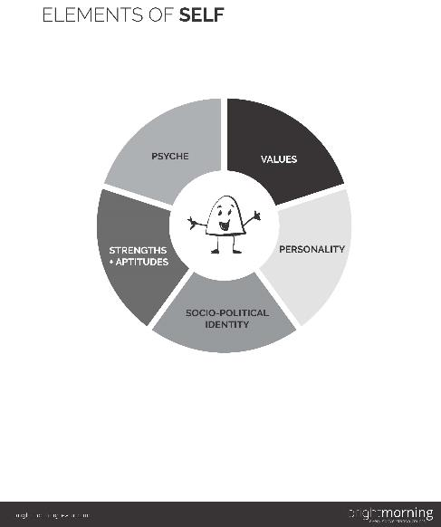
Build your PLRs through Knowing Yourself
Understanding who you are can improve your Psychological PLRs:
  Resilience
  Optimism
  Proactivity
  Self-Efficacy
Do you have awareness of how your emotions impact your day-to-day interactions with others?
What do you stand for? How do your values guide you?
Do you capitalize on your strengths?
Do you understand how your personality impacts your leadership style?
What impact do your social connections have on your decisions and interactions? Do you have any biases that interfere?
Free downloadable tool from http://www.onwardthebook.com/wp-content/uploads/2018/04/Elements-of-Self.pdf
Notes:
According to the Ideas into Action Publication # 8: Exploring the Psychological Personal Leadership Resources: Optimism, Self-Efficacy, Resilience & Proactivity, on page 23, one of the strategies that applies to all four Psychological PLRs (optimism, self-efficacy, resilience, proactivity) is to “know oneself”.
Knowing oneself is a strategy to improve resilience, optimism, proactivity, and self-efficacy.
Suggested timing: 5-10 minutes

Slide 9
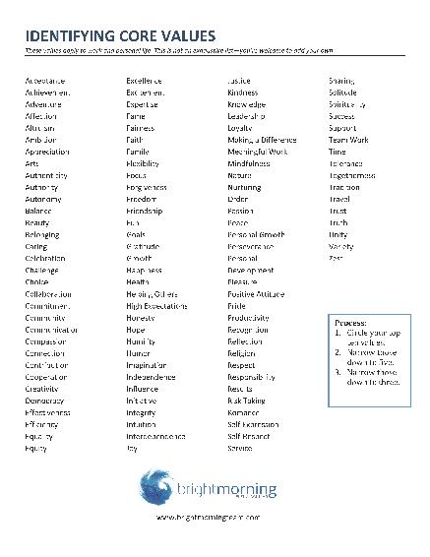
Core Values
Core Values in Action, Steve Kerr https://www.youtube.com/watch?v=fXEezjp-Df8
Circle 10
Cross off 5
Cross off 2 – These are your core values
Reflect (p.6 of the Reflective Manual).
Notes:
The assessments used for these activities will provide a glimpse into who you are in terms of your strengths, areas of growth and talents. They are to be used as reflective tools. Developing your self awareness is a lifelong effort, it needs to be cultivated. You may choose to use other assessment tools.
Activity:
View Steve Kerr: Core Values in Action then complete the activity: https://www.youtube.com/watch?v=fXEezjp-Df8. Refer to page 6 of the Reflective Manual.
From the list of words:
Circle 10 words that describe your core values.
Cross off 5 words that aren’t as strong.
Cross off 2 more words, those that remain represent your core values.
Refer to page 6 of the Reflective Manual or pages 25-27 of the Onward Workbook, and http://www.onwardthebook.com/wp-content/uploads/2018/09/Core-Values.pdf to complete the reflective activity.
Suggested timing: 10-15 minutes

Slide 10
Ontario Institute for Education Leadership
Ontario Leaders Collaborating for Student Achievement, Equity
and Well-being
Small Group Discussion
GUIDING QUESTIONS
What are your 3 core values?
In what ways do you articulate one of them as a leader?
Notes:
Participants meet in small groups to discuss.
Participants may choose to reflect on their own.
What are your 3 core values?
In what ways do you articulate one of them as a leader?
Suggested timing: 10-15 minutes

Slide 11
Ontario Institute for Education Leadership
Ontario Leaders Collaborating for Student Achievement, Equity
and Well-being
Personal Reflection
Complete the Myers Briggs Personality Test: https://www.16personalities.com/free-personality-test
See Reflective Manual page 7
Notes:
In the previous session, it was recommended that participants complete the Myers Briggs Personality test, https://www.16personalities.com/free-personality-test or refer to pages 17 to 22 of the Onward Workbook.
The Myers-Briggs Type Indicator is a tool designed to help participants define the aspects of their personalities. Once completed, participants will be able to determine their dominant personality type commonly referred to as their acronym. This is just one of many assessments that will help leaders know themselves better.
Suggested timing: 30 minutes

Slide 12
Myers-Briggs Personality Type
Personality Type Descriptors
ISTP – Virtuoso ESTP – Entrepreneur
ISFP – Adventurer ESFP – Entertainer
INFP – Mediator ENFP – Campaigner
INTP – Logician ENTP – Debater
ISTJ – Logistician ESTJ – Executive
ISFJ – Defender ESFJ – Consult
INFJ – Advocate ENFJ – Protagonist
INTJ – Architect ENTJ – Commander
16personalities.com
Notes:
These are the descriptors provided by 16personalities.com (https://www.16personalities.com/). Once participants have completed the Myers Briggs Personality Test and identified their personality type with the first letter of each descriptor used to form the four-letter acronym, refer to the chart above for a descriptor for their personality type.
The first letter is either I (for introverted) or E (for extroverted).
The second letter is either S (for sensing) or N (for intuitive).
The third letter is either T (for thinking) or F (for feeling).
The fourth letter is either J (for judging) or P (for perceiving).
Refer to pages 17 to 22 of the Onward Workbook or page 7 of the Reflective Manual.
What is your Personality Type?
Circle your personality type.
Extraversion or Introversion, Sensing or Intuition, Thinking or Feeling, Judging or Perceiving
Explain how extraversion or introversion impacts your leadership.
Participants will share with a partner what they learned about their personality types.
This is just one of many assessments that will help leaders know themselves better.
Review the descriptors and notice the differences. As a leader, it is important to be able to recognize these personality traits in order to draw from the various strengths of people we work with.
A sampling of evidence-based self-assessment surveys can be found on page 26 of the Ideas Into Action, Publication #8 Exploring the “Psychological” Personal Leadership Resources Optimism, Self-Efficacy, Resilience & Proactivity
Suggested timing: 10-15 minutes

Slide 13
Ontario Institute for Education Leadership
Ontario Leaders Collaborating for Student Achievement, Equity
and Well-being
Personal Reflection
What are your Strengths?
Complete the signature strengths survey: http://www.viacharacter.org.
Reflective Manual page 7
Notes:
What are your Strengths?
Complete the signature strengths survey: http://www.viacharacter.org.
Which strengths can you leverage as a leader?
You as a Catholic leader
What role does your faith have in defining how you lead?
Refer to the Personal Reflection on page 8 of the reflective manual.
If you have access to Elena Aguilar’s Onward Workbook, Complete page 52.
Suggested timing: 20-30 minutes

Slide 14
Ontario Institute for Education Leadership
Ontario Leaders Collaborating for Student Achievement, Equity
and Well-being
Character Strengths
Discovering your Strengths
Meet with a partner
Answer the reflection question on page 7 of the reflective manual
or
Complete the reflection on page 52 of the Onward Workbook
Notes:
Character Strengths
Discovering your Strengths
With a partner, discuss your findings to the reflective questions on page 7 of the Reflective Manual.
If participants have Elena Aguilar’s Onward Workbook and have completed page 52, discuss findings with partner. (optional)
Suggested timing: 10 minutes

Slide 15
Ontario Institute for Education Leadership
Ontario Leaders Collaborating for Student Achievement, Equity
and Well-being
Scenario
You are a newly appointed principal and your first School Council meeting is next week.
Explain how your core values, strengths and personality type may impact your approach with this important stakeholder group.
Notes:
Scenarios will be used as a way to bring theory into practice. These can be done in small groups, or as a large group share.
This scenario was created to allow participants to consolidate their learnings about their core values, strengths and personality type.
Reflect on the scenario. Each person will have 3-5 minutes to explain how these aspects will intersect with their ability to ensure the successful first meeting.
If there is a facilitator, the facilitator would provide an example to explain how what they learned about themselves impacted their approach to meeting with this group.
For example, “My main core value is making a difference. When meeting with the School Council, I will ensure that strategies we implement have a positive impact on all involved. If my main strength is collaboration, I will listen to and consider all voices thus ensuring everyone is valued and heard. If an aspect of my personality type is introversion, I will likely hear the views of others before voicing my own.”
Suggested timing: 15-20 minutes

Slide 16
Ontario Institute for Education Leadership
Ontario Leaders Collaborating for Student Achievement, Equity
and Well-being
Next Steps …
1
3
2
Read Section C of Ideas into Action
Review the IEL Self-Assessment
Read p. 19 of Renewing the Promise
Notes:
In preparation for module 3 of the psychological PLR series, read section C of the Ideas Into Action Publication # 8: Exploring the Psychological Personal Leadership Resources: Optimism, Self-Efficacy, Resilience & Proactivity. This publication suggests ‘ten proven strategies’ that include one or more approaches for developing and strengthening our psychological PLRs. These strategies will inform the next steps in the individual’s plan of action.
The IEL self-assessment completed in the previous session will also provide valuable data to the individual’s plan of action.
Catholic School Leaders will have the opportunity to complete page 19 of Renewing the Promise. This will provide details of the responsibilities of principals/vice-principals in furthering Catholic Education. The Renewing the Promise can also be found on page 9 of the Reflective Manual or visit https://iceont.ca/wp-content/uploads/2018/05/2018-Renewing_The_Promise_A_Pastoral_Letter.pdf (pp. 17-22).

Slide 17
Ontario Institute for Education Leadership
Ontario Leaders Collaborating for Student Achievement, Equity
and Well-being
Resources for leaders
www.education-leadership-Ontario.ca
https://twitter.com/IELOntario
communication@education-leadership-ontario.ca
www.education-leadership-Ontario.ca
Notes:
We invite you to visit the IEL website to learn more about other resources and research that could be used to support your professional growth.

Slide 18

Ontario Institute for Education Leadership
Ontario Leaders Collaborating for Student Achievement, Equity
and Well-being
KEEP GROWING
          and

